Slide 1
Four Principles of Low-Risk Software Releases
by Jez Humble
●Cátedra: Ingeniería de Software - UTN FRC
●Docentes: Meles, Judith
Robles, Joaquín
●Grupo N°1
Ciclo lectivo 2017

Slide 2


“One key goal of continuous deployment is to reduce the risk of releasing software”

Slide 3
Principle 1: Low-Risk Releases Are Incremental
DEPENDENT SERVICE
Database
1.0
1.1
Abtraction layer
Abtraction layer
STATIC CONTENT
APPLICATION
Router/Load balancer
Interwebs

Slide 4
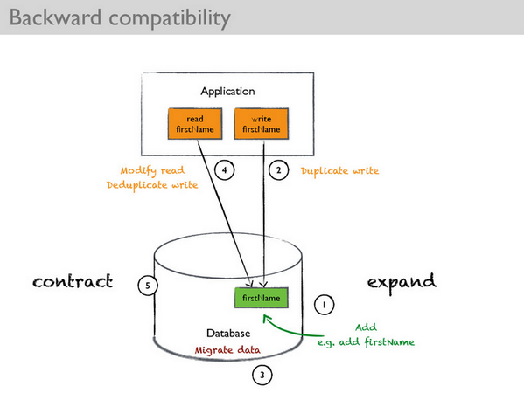
Divide The Changes Into Reversible Steps

Slide 5
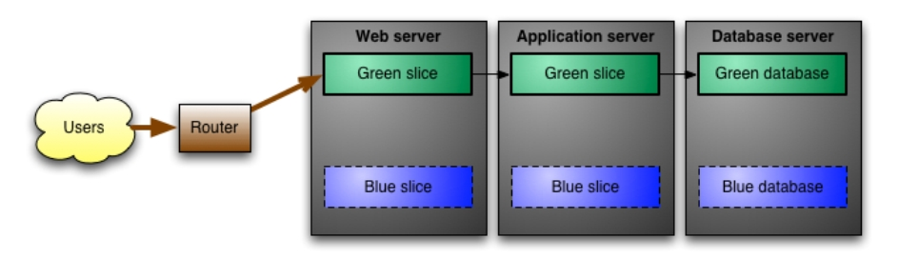
Blue-Green Deployment

Slide 6
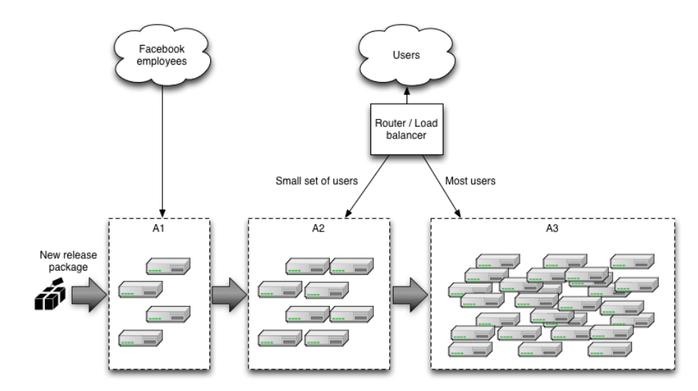
Canary Releasing

Slide 7
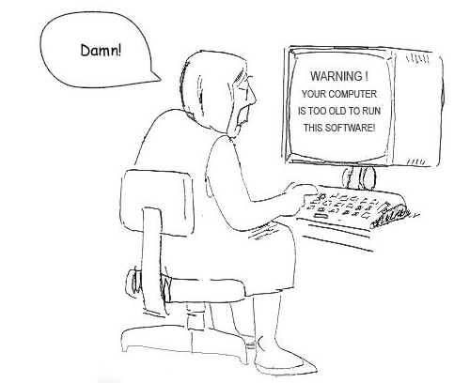
Software Versions

Slide 8



Principle 2: Decouple Deployment and Release

Slide 9
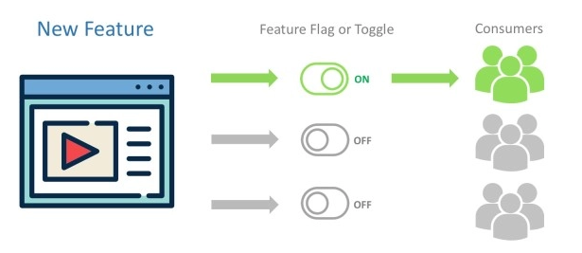
Dark Launching

Slide 10

Feedback

Slide 11
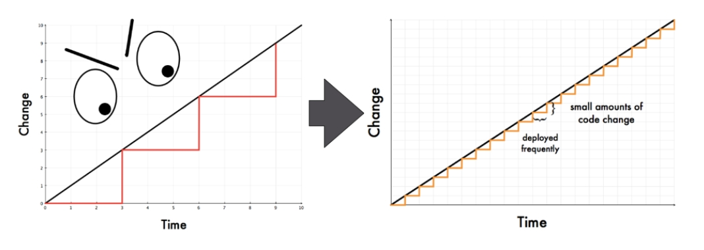
Principle 3: Focus On Reducing Batch Size

Slide 12
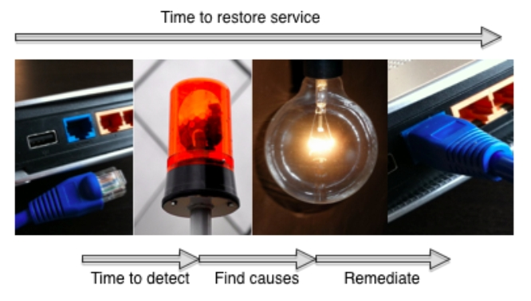
Lifecycle Of An Incident

Slide 13
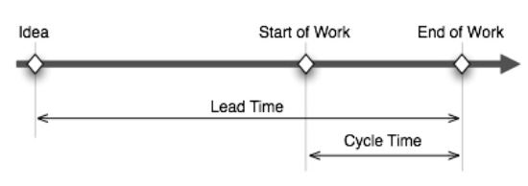
Lead Time & Cycle Time

Slide 14

Principle 4: Optimize For Resilience

Slide 15

Configuration Information

Slide 16

“Chaos Monkey”

Slide 17

“Works Of Art”

Slide 18

Conclusions
Remediation

Slide 19
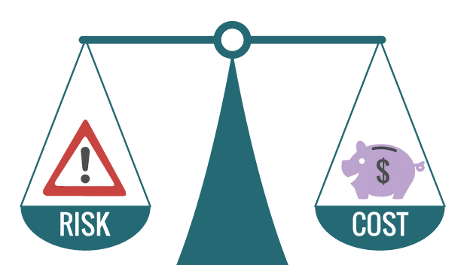
Conclusions
Temporal discounting

Slide 20

Conclusions

